Slide 1
Search Techniques

Slide 2

Objective
By the end of this module, participants will be able to perform keyword searches

Slide 3
American Standard Code for Information Interchange (ASCII)
A character-encoding scheme originally based on U.S. English
Uses 8 bits per characters
Is limited to 256 character codes

Slide 4
ASCII Table Overview
The ASCII table consists of the codes for:
Characters (Codes 0-127)
Decimal values (Codes 128-255)
It contains characters found in the Latin alphabet and other characters

Slide 5
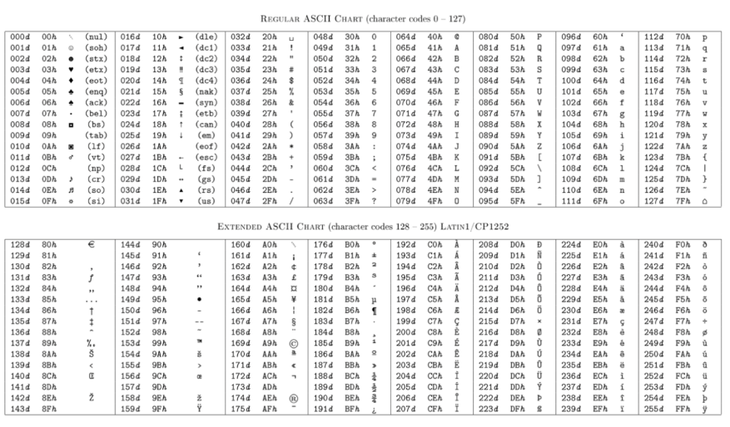
ASCII Table

Slide 6
Unicode
Initially, telegraph and computers used only English/Latin characters
When other languages were required, ASCII character codes were insufficient

Slide 7
Unicode
Uses a unique two-byte number for every character
Can define more than 65,000 characters, allowing the computer to display any world language

Slide 8
Plain Text
ASCII

Slide 9
Arabic is Unicode Only and
Does not Display in Courier Display Font
Notes:
Arabic should appear here, but does not.
big-endian and little-endian
Posted by: Margaret Rouse
WhatIs.com
Contributor(s): Diethard Ohrt
Sponsored News
Managing Opex by Cutting Power, Cooling and Physical Space Costs Through ... –Dell
Performance and Scalability for High-Availability Workloads –Dell
See More
Vendor Resources
Empowering IT to Transform and Take Advantage of Database Technologies –IBM
POWER8: A Processor to Challenge Intel's Dominance –IBM
Big-endian and little-endian are terms that describe the order in which a sequence of bytes are stored in computer memory. Big-endian is an order in which the "big end" (most significant value in the sequence) is stored first (at the lowest storage address). Little-endian is an order in which the "little end" (least significant value in the sequence) is stored first. For example, in a big-endian computer, the two bytes required for the hexadecimal number 4F52 would be stored as 4F52 in storage (if 4F is stored at storage address 1000, for example, 52 will be at address 1001). In a little-endian system, it would be stored as 524F (52 at address 1000, 4F at 1001).

Slide 10
Same Characters in
Unicode

Slide 11
Modifying the Display Font
To display Unicode fonts, go to: Tools > Options > Fonts

Slide 12
Changing the Font
Select Arial Unicode MS Font

Slide 13
Changing
Code page
Notes:
Change Codepage from Western European (Win) to Unicode

Slide 14
Changing Reading Direction
On Options Menu, Check RTL Reading

Slide 15
Arabic Displayed
Correctly

Slide 16
EnCase
Search Techniques

Slide 17
Conducting an Index Search
To create the index:
Run the EnCase Evidence Processor
Enable the Index text and metadata feature
Index personal information (optional)

Slide 18
Searching and Viewing
Results
Notes:
Open the Search view and enter a keyword
View results in the bottom pane
Bookmark or save relevant results

Slide 19
Proximity Searches
Keyword1 w/35 Keyword2 or keywords in quotes
Boolean logic
Stemming and fuzzy searches
Pattern searches

Slide 20
New Raw Search
Selected
To Conduct Live Search
Notes:
To conduct a live search of raw data, choose New Raw Search Selected

Slide 21
Creating a New Keyword
On the New Raw Search Selected Menu:
Name the search
Select the path for storage
Click New in the keywords toolbar

Slide 22
Keyword Search Expression
On the New Keyword Menu:
Type the keyword under Search Expression
Select the Unicode search option

Slide 23
Running the Search
Verify the file name, path, and search options
Click OK to start the search
Monitor the progress bar

Slide 24
Viewing the
Results
Notes:
The Results view shows search hits

Slide 25
GREP Search
Global Regular Expression Parser (GREP):
Searches for plain text with regular expressions
Matches strings of text against characters, words, numbers, patterns, wildcards, etc.

Slide 26
GREP Symbols
From the New Keyword Menu, select GREP symbols to combine with text and numbers

Slide 27
GREP Examples
GREP Search | Results
re[ae]d | Will find read or reed
reads? | Will find read or reads
classif(y)|(ied)|(ies) | Will find classify or classified or classifies

Slide 28
Using the Keyword Tester
On the New Keyword menu, go to the keyword tester tab
Test the GREP search on a list you created

Slide 29
Data Carving
Locates files, primarily in unallocated spaces, based on file signature (header)
Can be:
Used against RAM dumps, swap files, and hibernation files
Performed manually or automated

Slide 30
Manual Data Carving
From File Types View, Copy JPG Header

Slide 31
Selecting Unallocated Cluster for GREP Raw Search
Notes:
Select only the Unallocated Clusters
Open the Raw Search Selected menu, go to the Evidence toolbar, and select New Raw Search Selected

Slide 32
Creating the GREP Keyword
From the New Keyword Menu, paste the JPG header

Slide 33
Running the Search
On the New Raw Search Selected menu, name the search file and path, then click OK

Slide 34
Monitor the Search Progress Bar
Notes:
Monitor the search progress bar at the bottom of the screen

Slide 35
Viewing the Results
Go to Search View Keyword Tab
Notes:
Go to Search View Keyword Tab
Highlight the JPG Header with the first byte

Slide 36
Decode and View Results
Decode Tab, Choose Picture Type
Notes:
From the decode tab, choose picture type

Slide 37
Bookmark the Results,
Right-click the Picture, Bookmark it as Data Structure
Notes:
Right-click the image
Bookmark it as Data Structure

Slide 38
Select the Destination
Go to the Data Structure menu destination tab
Under Relevant Images, choose Notable Images

Slide 39
View the
Report
Notes:
Open the Report view
Scroll to Notable Images

Slide 40
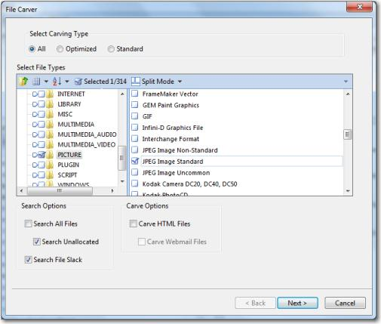
Automated File Carver
Easier than the manual method
Select options, click OK, and view the results

Slide 41
FTK
Search Techniques

Slide 42
FTK Searching Features
FTK supports:
Indexed searches
Raw searches, including regular expressions
Data carving through its evidence processing feature set
Unicode character sets

Slide 43
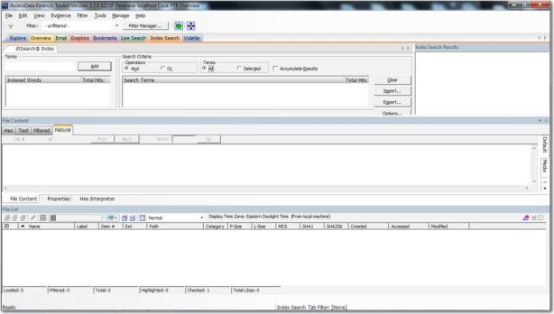
FTK Index
Searching
Notes:
Type a keyword
Select hits from the keyword and its derivatives

Slide 44
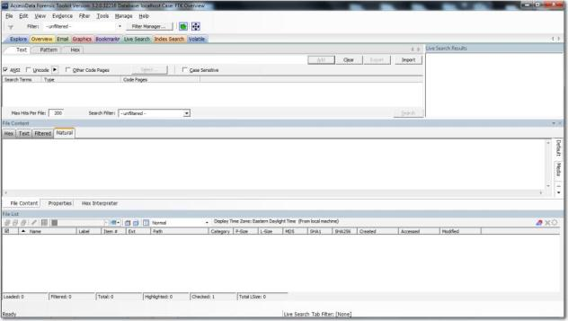
FTK Live
Searching
Notes:
Raw or live searches take time to complete
Use REGEX expressions for pattern searching

Slide 45
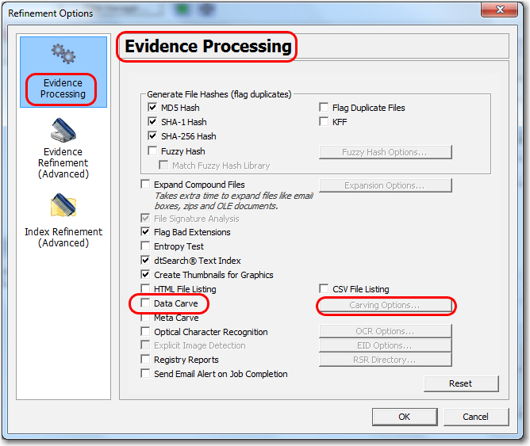
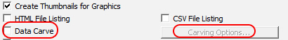
FTK Data Carving Feature

Slide 46
Summary
You should now be familiar with:
Storage and search of ASCII and Unicode text
Types of keyword searches
Index, live or raw keyword, and GREP searches
Data carving based on file signatures
Foreign language views and searches

Slide 47
Thanks!
Any questions?

